Slide 1

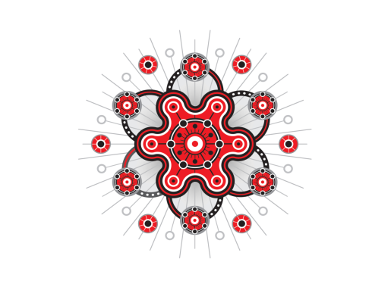

Finding Terra Nullius: A personal journey in mathematics education
Dr Chris Matthews
Senior Lecturer, Griffith School of Environment
Griffith University
and
Patron, Make It Count Project,
Australia Association of Mathematics Teachers (AAMT)

Slide 2
Computers
Parents
Mathematics
Science Fiction
Start of the Computer Age
Student
Racism
Logic
Facts
Hiding in Objectivity
Teacher
Prevalence of Land Rights
1988
Bicentennial/Expo
1967
Referendum
1972
Tent Embassy
1982
Commonwealth Games

Slide 3
Questions I struggle with:
As an Aboriginal person, why would you study mathematics?
What is the connection between culture and mathematics?
Will such a connection improve educational outcomes for our children?

Slide 4
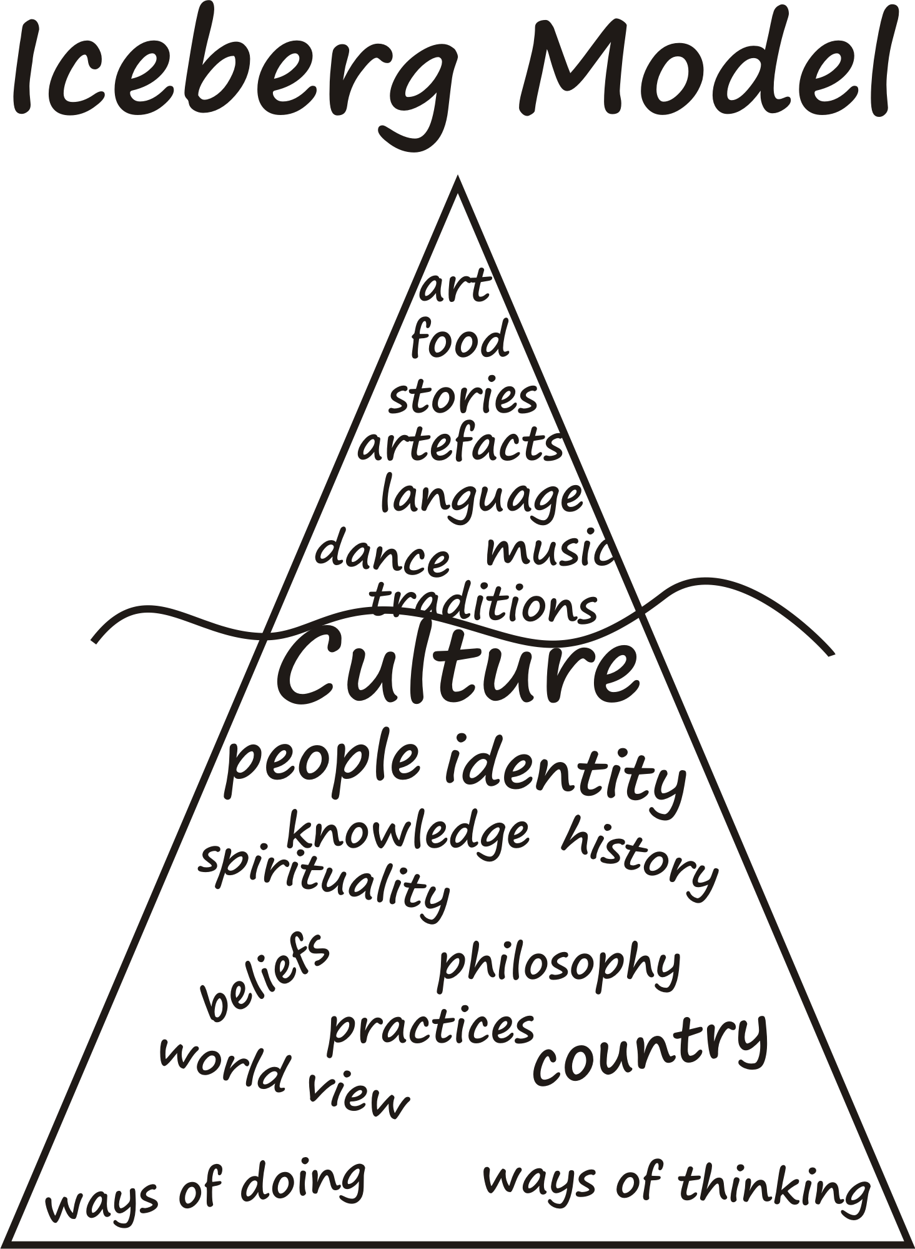
What is Culture?

Slide 5
What is Mathematics?
Picture the typical stereotypical Scientist?
Nerd, social recluse, special innate ability
Fear and Anxiety
Love and Fun (Occasionally)
Numbers
Problem Solving
Measurement
Space etc
Who does this type of maths?
Engineers, Scientists…
Maths
What other Maths is there?
Matrices, Calculus, Numerical Computation, Topology, Number Theory …
Who does Maths?
Everyone !
What Maths does “everyone” do?
Money, Measurement, Trades, Direction …
Number, Operations, some algebra

Slide 6
Terra Nullius
Our Shared History Our Relationship
dispossessed
Advanced
No opportunity
marginalised
Fear
Indigenous
non-Indigenous
Mistrust
Good Will
primitive
valued
devalued
Knowledge holders
No relevance
Silence

Slide 7
Overturn the mindset of Terra Nullius
Does mathematics education (and research) devalue Indigenous people?
Educational providers (and researchers) need to build positive relationships with Indigenous communities.
Build connections between culture and curriculum including mathematics.

Slide 8
What is Mathematics?
Abstraction
Creative
Reality
Symbols
Maths
Cultural Bias
Critical Reflection

Slide 9
Maths as Storytelling (MAST)
Has five main steps:
Explore the meaning of symbols;
Act out a simple maths (addition) story;
Create their own representation and symbolism;
Sharing symbols;
Modify the story.

Slide 10

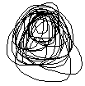

Step 4: Sharing of Symbols
Provides an opportunity for students to share the symbols and personal meaning;
Example, from Year 2 student
Using other students symbols;
Teachers may learn more about the students;

Slide 11
Step 5. Modify the story
Does the new story make sense?
1) Put it back
2) Place nut in the other group on the action side;
3) Take a nut away from the result side

Slide 12
Step 5. Modify the story
A Year 2 student showed us a 4th Strategy

Slide 13
Make it Count Project Maths Camp, Nerang Cluster
Teaching mathematics through Aboriginal Dance: Kargun Fogarty;
Student Responses:
“I like dance and the culture of the maths we are learning”,
“I learnt that maths does not have to be about sitting at a desk looking and copying off a board”,
“We mixed our culture and maths together and it surprised me. I can now walk away with a different understanding of Math and my Aboriginal heritage”

